Slide 1
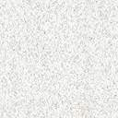
Mocs2A deletion mutants (EPG¹⁶⁵⁴⁰ screen)
EP^{G16540}
vig2
*
*
Mocs2A+Mocs2B
*
Clbn
Wild type
vig2
*
*
Mocs2A+Mocs2B
Clbn
779 bp deletion
Mocs2A^{Δ28A}
vig2
*
*
Mocs2A+Mocs2B
Clbn
468 bp
Mocs2A^{Δ21A}
EP^{G16540}43bp
vig2
*
*
Mocs2A+Mocs2B
*
Clbn
Mocs2A^{Δ1A}

Slide 2
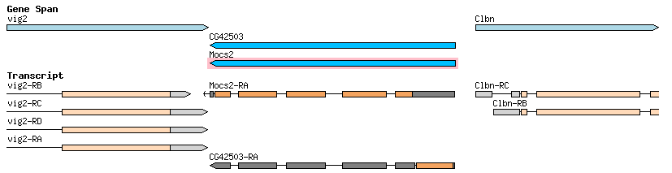
Mocs2A^{Δ21A}
= Deleted area

Slide 3
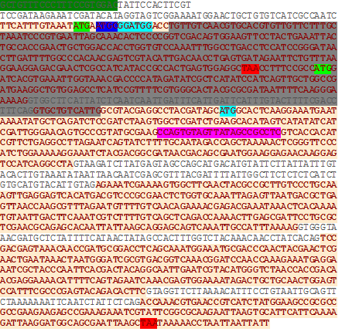
= Deleted area

Slide 4
Mocs2A^{Δ28A}
= Deleted area

Slide 5
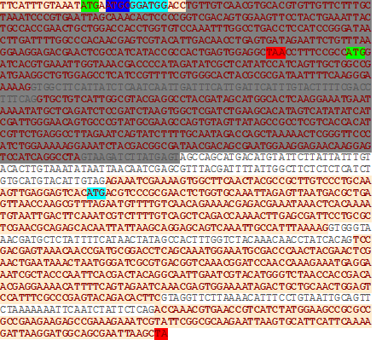
= Deleted area

